Slide 1
Encapsulation and package
Session 6
D6421 – Muhammad Fikri Hasani

Slide 2
Outline
Course outline
Package Definition
Creating Package
Creating Class inside Package
Accessing Class from Package
Multilevel Package
Encapsulation definition
Access modifier

Slide 3
Encapsulation and package
Package definition
We have learnt how to create a class, how to use such class as an object.
Now, we will learn how to structure project using package concept.
A package in Java is used to group related classes. Think of it as a folder in a file directory.
We use packages to avoid name conflicts, and to write a better maintainable code.
Package also help to encapsulate classes and its behaviour or atrributes
There are two kinds of package:
  Built-in Packages (packages from the Java API)
  User-defined Packages (create your own packages)

Slide 4
Encapsulation and package
Built in packages
In Java, built-in packages are pre-defined packages that come with the Java Development Kit (JDK) or Java Runtime Environment (JRE).
These packages contain a large number of classes and interfaces that are fundamental to the Java programming language
Examples of built in java packages:
  java.util → Contains the collections framework, some internationalization support classes, properties, random number generation classes. Classes like ArrayList, LinkedList, HashMap, Calendar, Date, TimeZone, Scanner, etc are part of this package.
  java.sql → Provides the classes for accessing and processing data stored in a database. Classes like Connection, DriverManager, PreparedStatement, ResultSet, Statement etc are part of this package
  java.lang → Contains classes and interfaces that are fundamental to the design of Java programming language. Classes like String, StringBuffer, System, Math, Integer, Boolean, Character, etc are part of this package.
  java.io → Provides classes for system input/output operations. Classes like BufferedReader, BufferedWriter, File, InputStream, OutputStream, PrintStream, Serializable etc are part of this package.

Slide 5
Encapsulation and package
User defined package and its advantages
User defined package is a package that is package that is being custom made by developer
It often used to help categorizing classes that perform similar tasks
User defined Packages in Java can help in coupling and cohesion of project components.
Coupling → degree of interdependence between software modules.
Cohesion → degree to which the elements within a module are related to each other and united in their purpose.
Packages can help in achieving loose coupling and high cohesion by organizing related classes and interfaces into a single unit.
By grouping related classes and interfaces into a package, we can reduce the interdependence between modules and increase the independence of each module.
This can lead to better software design and easier maintenance

Slide 6
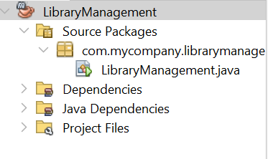
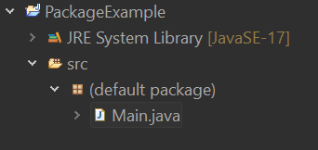
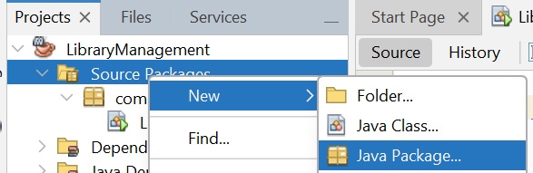
Encapsulation and package
Creating package
Lets see an example of a project structure. Left is netbeans, right is eclipse (it may differ again if you are using IntelliJ or VS Code:
All the code sources file are placed inside the source packages (netbeans) or src folder (eclipse). The main java program by default are actually inside a package. For this topics the example will be delivered using netbeans.
To create a package, simply right click and choose a new java package:

Slide 7
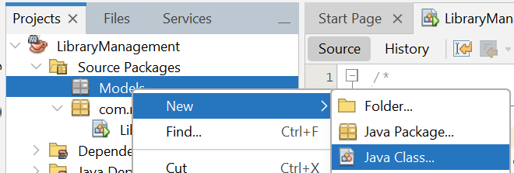
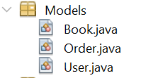


Encapsulation and package
Creating package with case study
To get a more thorough understanding of package, lets create a mini console java project.
This project is about Library management, that can handle users (or customers) who able to order a book or more from this library book collection.
Therefore, we will create several classes to store data, named Book, User, and Order.
First, we will create a new package named model that hold multiple classes that served to store data.
After that, create each class by creating new java class inside it.
The package structure will be like this:

Slide 8
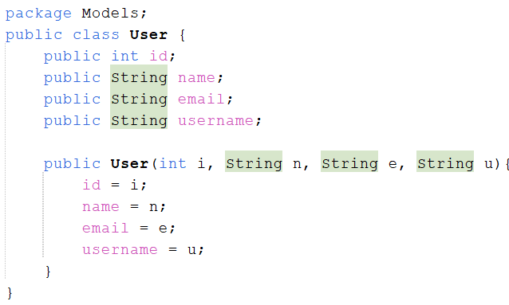
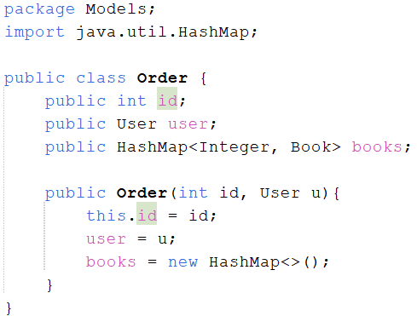
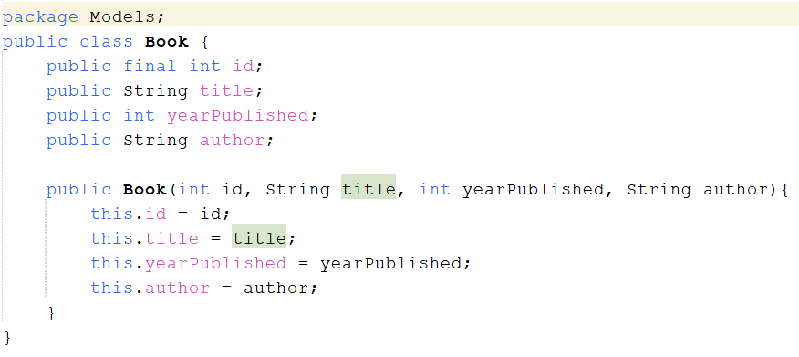


Encapsulation and package
Creating package with case study
When a class is created inside of a package, there will be a new line on top of the code with syntax “package x”. Here are three classes inside models package:
Order
user
Book

Slide 9
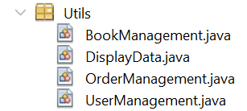
Encapsulation and package
Accessing Class from package
There are two ways of accessing class in package:
  Classes in the same package. Here, we can directly call the Class.
  Classes in different package. Here, we need to import the class.
Example: still in the same project, we will create a utility package named “Utils”, that contains a class named DisplayData, OrderManagement, BookManagement, and UserManagement:
Both will need the model class to perform. UserManagement will handle User such as creating user, and insert into our collection of users in the main program. Therefore, we will do the process of “importing” class

Slide 10
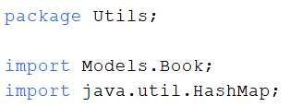
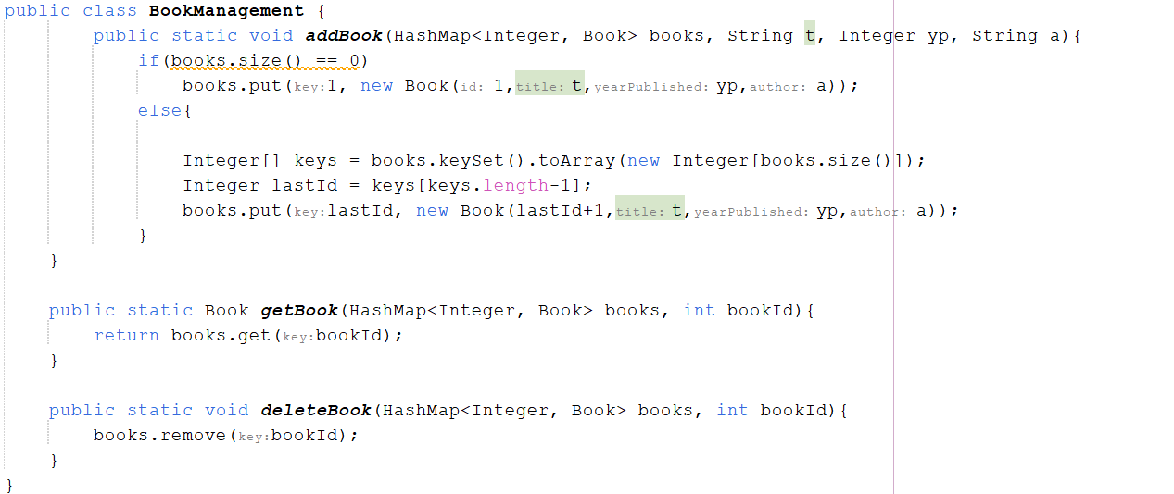
Encapsulation and package
Accessing Class from package
Importing class is a way of accessing class from another package.
The syntax is: import Package.[subpackages.]Class. If there are multilevel package, we also need to add the subpackage(s). Example here is one of the the imports in BookManagement class:
Lets continue our project. The book class are able to handle tasks related to Book, such as input new book to library, remove book from library, and get book from library, therefore the Book Management will be:

Slide 11
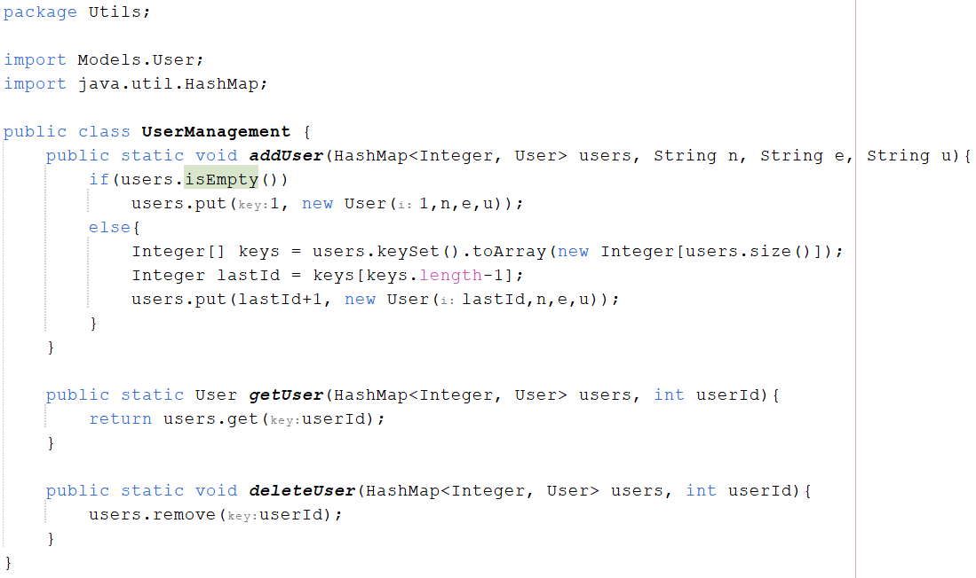


Encapsulation and package
Accessing Class from package
For the UserManagement class, the logic doesn’t differ much from BookManagement.
This class will handle Management data of User. Hence, the code for UserManagement will be:
Notice the import statement used and the classes being imported

Slide 12
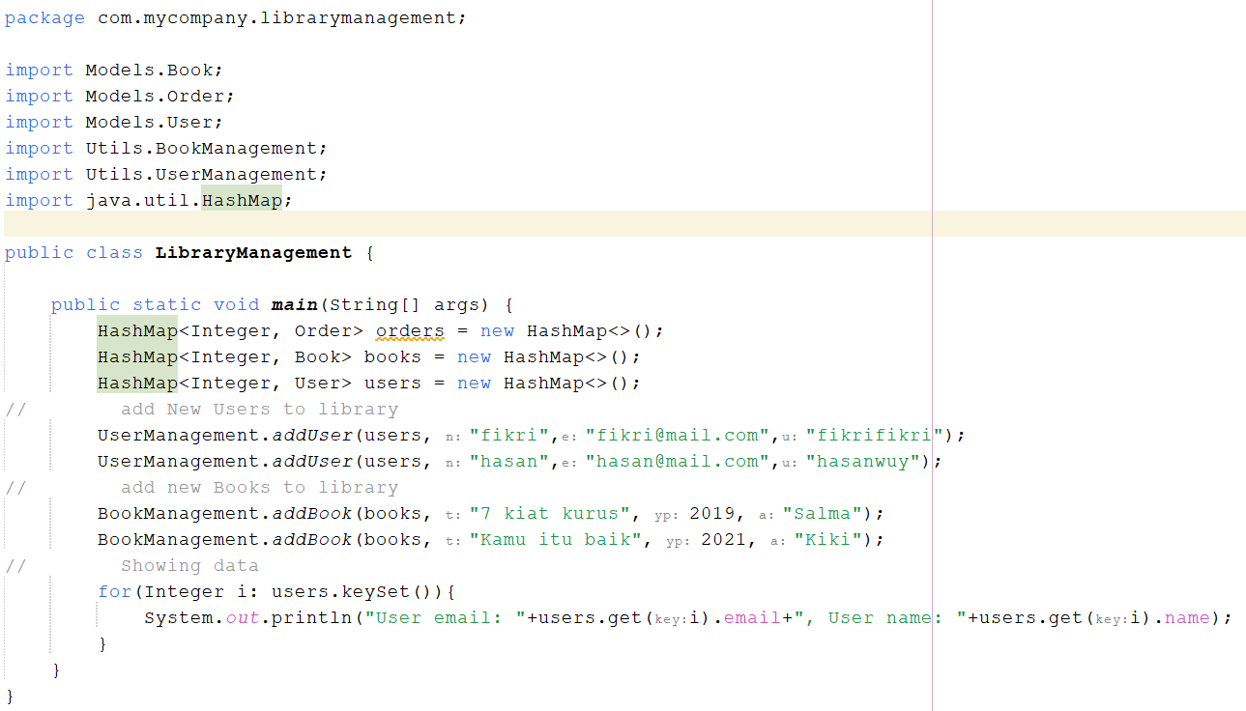
Encapsulation and package
Accessing Class from package
In the main class, we will access all this class and methods.
Therefore, we will import these models classes and utility classes inside our LibraryManagement Class (or main class).
The code for our main class:
Try to copy these code and see the
result.

Slide 13
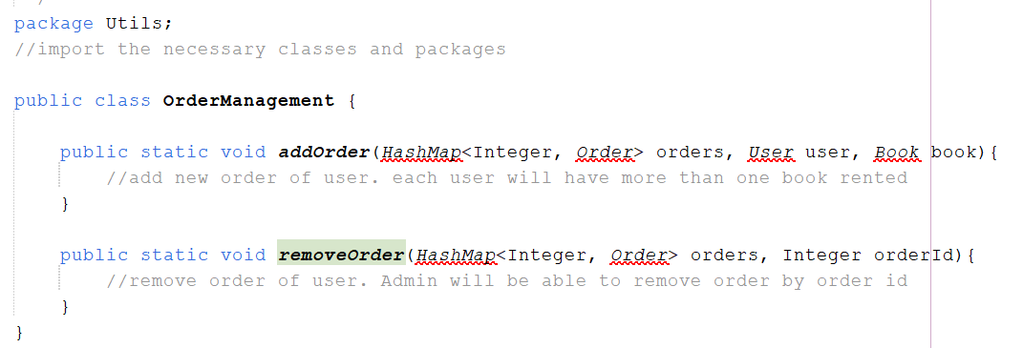
Encapsulation and package
Exercise 1
Complete the program by completing the methods from OrderManagement class:
Complete the DisplayData class methods (Next Slide).

Slide 14
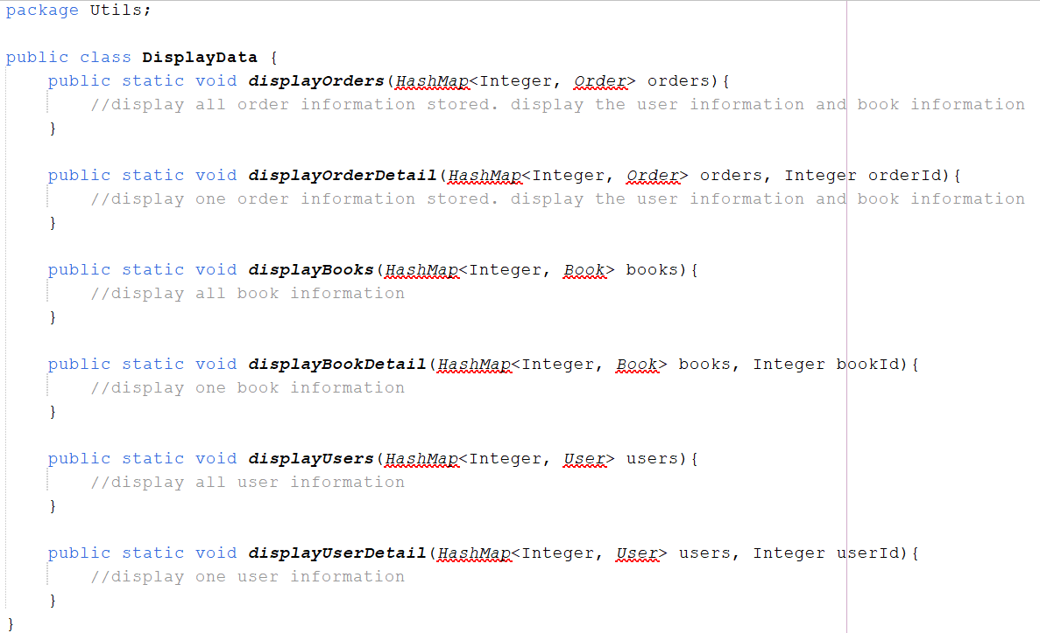
Encapsulation and package
Exercise 1
Complete the DisplayData class methods:

Slide 15
Encapsulation and package
Exercise 2
Change the utils package directory!
Create two subpackage from utils named:
  Display. This package will contain DisplayBook (display book information) , DisplayUser (display user information), and DisplayOrder (display order information) classes. To create these class, split the DisplayData class (general display data utility) from previous slide to these 3 classes that do specific display of information.
  DataManagement. This package will contain OrderManagement, UserManag ement, and BookManagement.
Make sure the program still run without bug. Change your Main class program code to handle these changes.

Slide 16
Object oriented concept and encapsulation
Encapsulation
is a fundamental concept in Object-Oriented Programming (OOP) that refers to the bundling of data with the methods that operate on that data.
It restricts direct access to some of an object’s components, which is a means of preventing accidental interference and misuse of the data.
This access restriction was made possible by concept of access modifier
Private : hide the class members so not accessible from outside the class
Protected : allows members of the class can be accessed by the class or its derivatives in the classroom several similar packages.
Public : allows the member class can be accessed by other classes class
Package : used to organize classes. If the class that was created without using the package statement, the class will be placed in the default package.

Slide 17
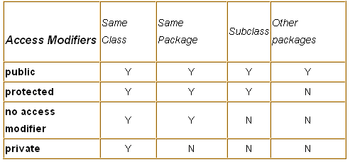
Package and encapsulation
Access modifier

Slide 18
Package and encapsulation
Setter and getter
To access unaccessable methods or variables, use setter and getter approach. example
// A class that represents a person
public class Person {
// A private variable that stores the name of the person
private String name;
// A public method that returns the name of the person
public String getName() {
return name;
}
// A public method that sets the name of the person
public void setName(String newName) {
name = newName;
}
}

Slide 19
Package and encapsulation
Setter and getter
Name is unaccessible because it is private. Hence, the setter and getter will be used to access name variable:
// A class that tests the setter and getter methods
class Main {
public static void main(String[] args) {
// Create a person object
Person p = new Person();
// Set the name of the person using the setter method
p.setName("Alice");
// Get the name of the person using the getter method
System.out.println(p.getName()); // Prints "Alice"
}
}

Slide 20
Encapsulation and package
Exercise 3
Try changing the access modifier of id and email from user into private
Use setter and getter to access those private variables

Slide 21
Object oriented concept and encapsulation
reference
Daniel Liang, Introduction to Java Programming and Data Structure, 13th edition.

